Slide 1
Machine Learning Project
Group 18
蔡鑫鹏（Leader)，唐知行，熊志丽，贺飞，邓鸿

Slide 2
Outline
Model & Method
Implementation
Performance & Problems

Slide 3
Model & Method

Slide 4
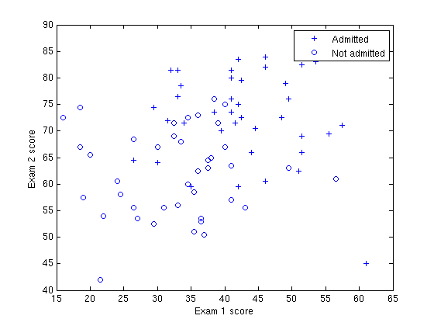
Model Description
A prediction model for college admission chances
Notes:
For this exercise, suppose that a high school has a dataset representing 40 students who were admitted to college and 40 students who were not admitted. Each training example contains a student's score on two standardized exams and a label of whether the student was admitted.
Your task is to build a binary classification model that estimates college admission chances based on a student's scores on two exams. In your training data,
a. The first column of your x array represents all Test 1 scores, and the second column represents all Test 2 scores.
b. The y vector uses '1' to label a student who was admitted and '0' to label a student who was not admitted.

Slide 5

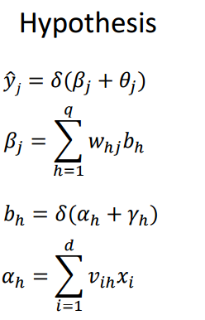


















Method
3-layer Forward Neural Networks Structure
output layer
hidden layer
…
…
input layer

Slide 6
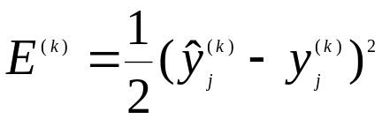

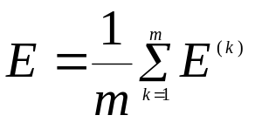
Back Propagation Algorithm
Method
Cost Function:
Parameters:
Goal: minimize
Notes:
Minimize cumulative error on training set D use gradient descent, and adjust the parameters in the negative gradient direction of the target.

Slide 7
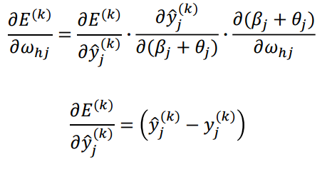

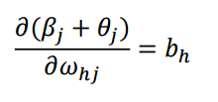
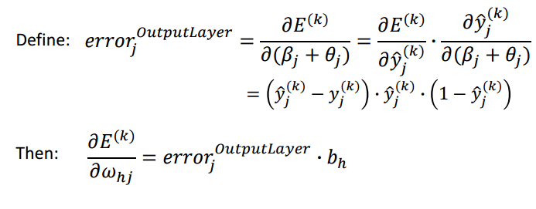

Slide 8
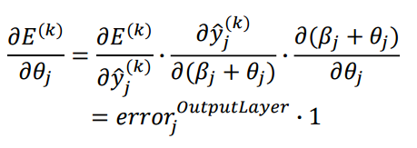
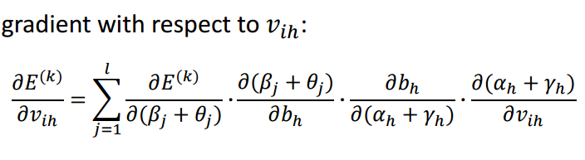




Slide 9
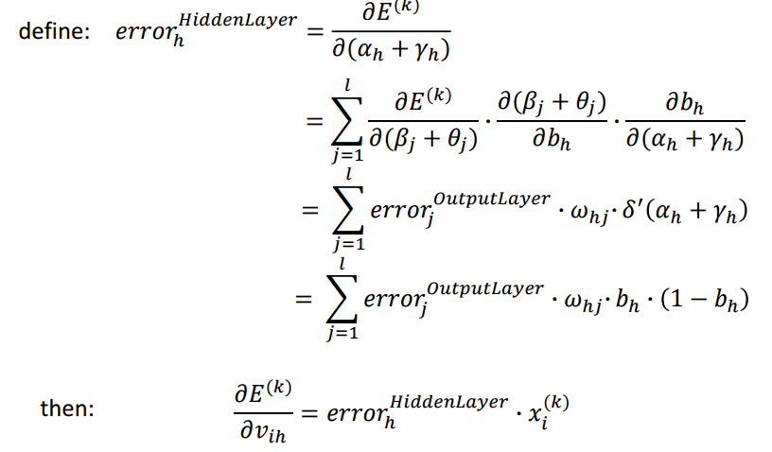
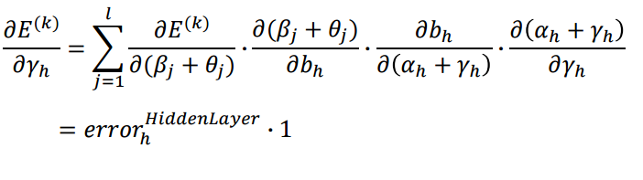

Slide 10
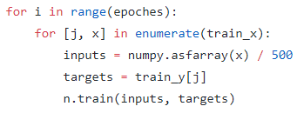

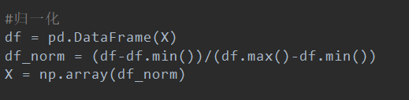

Procedure
Method
Input:
Training Set:
Learning Rate:
Normalization
(Without TensorFlow)
(With TensorFlow)

Slide 11
Process:
Randomly initialize all connection weights and thresholds in the network within the range (0,1) with normal distribution.
Repeat forward propagation and back propagation for each epoch until reaching the set number of epoch.
Output:
Trained ANN
Notes:
and thresholds ????????

Slide 12



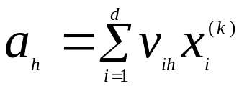

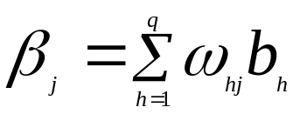

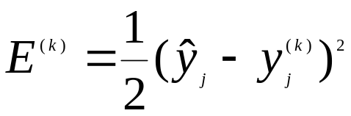




Process of a single epoch
input # the sample, k
compute # the output of input layer
also the input to hidden layer
compute # the output of hidden layer
Forward
Propagation
compute # the input to output layer
compute # the output of output layer
compute # cost function
compute # use
# use

Slide 13
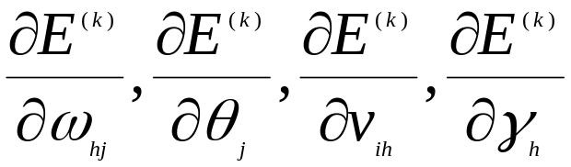

Back Propagation
update
k++ until k>m

Slide 14
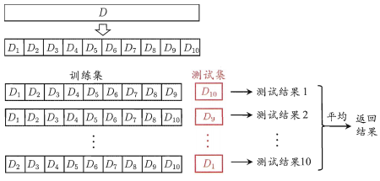
k-fold cross validation
Method
Goal:
Checking overfitting effect and predicting the performance of a model on unavailable data.
Notes:
In actual training, the model usually fits well to the training data, but the degree of fitting to the testing set is poor. Used to evaluate the generalization ability of the model, select the model we need.

Slide 15
Implementation

Slide 16
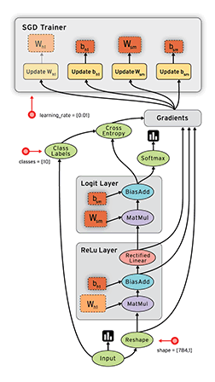
TensorFlow
Notes:
Tensor can be easily understood as a multidimensional array. Flow is a data stream that expresses the process of converting between tensors by calculation. He calculates the value through the data flow graph. Nodes represent data and operations, while edges represent the relationship between input and output between nodes. Once all tensors at the input are ready, the nodes are assigned to various computing devices to perform asynchronous parallel operations.

Slide 17

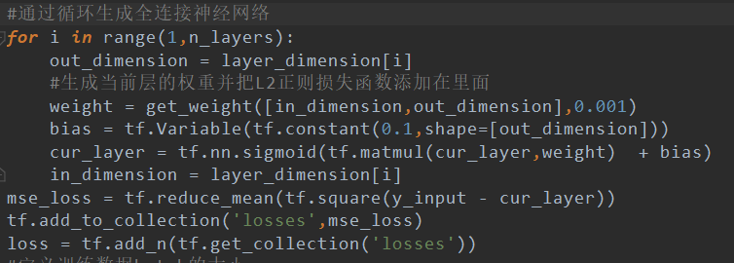

Coding
without TensorFlow
with TensorFlow

Slide 18

Coding
without Regularization
with L1 Regularization

Slide 19
Performance & Problems

Slide 20
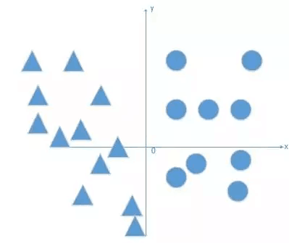
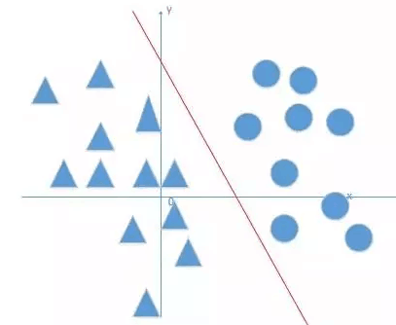
Bias
Question: Classify the round and triangle below
Without bias
With bias
Notes:
all our dividing lines are through the origin

Slide 21


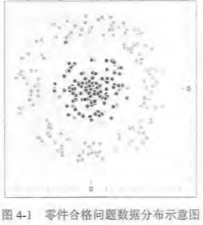
Activation Function
Goal: Nonlinearization
Linear model: the weighted sum of the input is the output
The relationship between input and output can be expressed as
Limitations of linear models
There is no difference in the expressive power of the fully connected neural network of any layer and the single-layer neural network model, just by linear transformation, they are all linear models. The problems that linear models can solve are limited.
eg.
In the real world, most of the problems are not linearly segmented. We need activation functions to achieve nonelinearization.

Slide 22
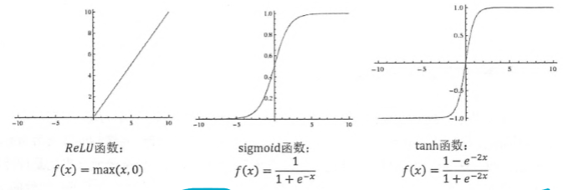
Activation Function
Function | ReLU | Sigmoid | tanh
Advantages | Easy for derivation Avoid gradient vanishing Less calculation load | Easy for derivation Result can be interpreted as probability. | High convergence rate
Disadvantages | Tend to blow up activation Dying ReLU problem | Gradient saturating | Gradient saturating
Notes:
Therefore, the convergence speed is slower. Particularly, when the initialization weight is too large, it will be saturated at the beginning, so that it cannot be iteratively updated;

Slide 23
Activation Function
Activation Function | Accuracy(%)
none | 72.5
sigmoid | 80
tanh | 77.5
ReLU | 50
softplus | 78.75

Slide 24
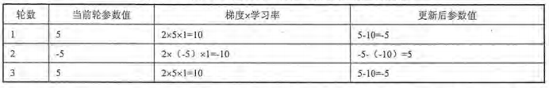
Learning Rate
Iteration process when the learning rate is too large
No matter how many rounds of iterations, the parameters will swing between -5 and 5, and can't converge to a minimum. If the learning rate is too small, though it can converge, the optimization time will be greatly extended.
In summary, the learning rate should not be too large or too small.
We use exponential decay to solve the problem.
Process:
Learning rate will decrease after one epoch. When using continuous exponential decay learning rate, different training data have different learning rates. When the learning rate is reduced, the corresponding training data has less influence on the model training results.
Notes:
换图

Slide 25
Learning Rate
Notes:
换图

Slide 26
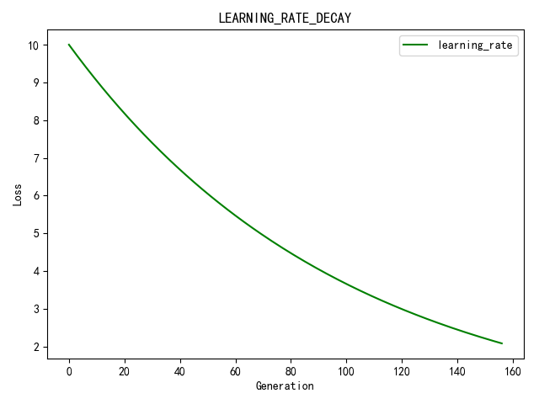
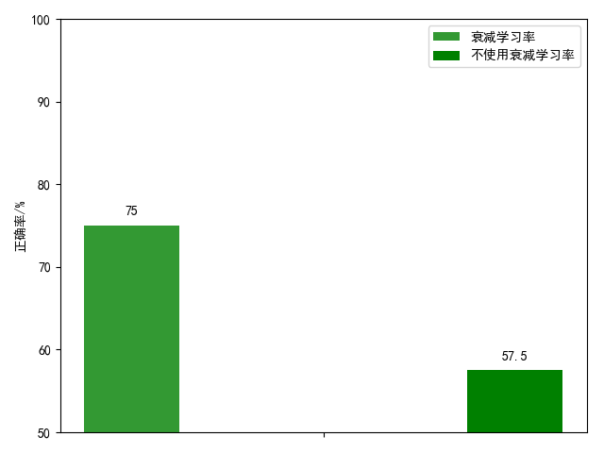
Learning Rate
with exponential decay without exponential decay
Notes:
In the beginning, if we chose the learning rate randomly, we can get the optimal solution faster by using learning rate decay.

Slide 27
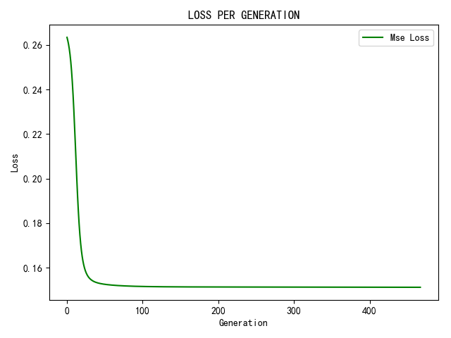
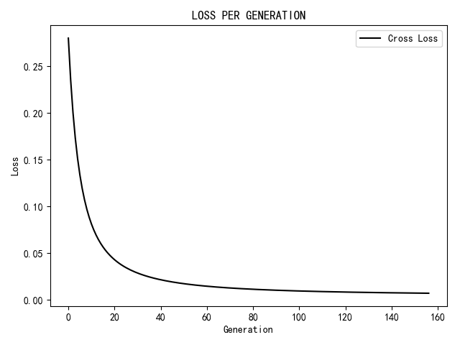
Loss Function

Slide 28
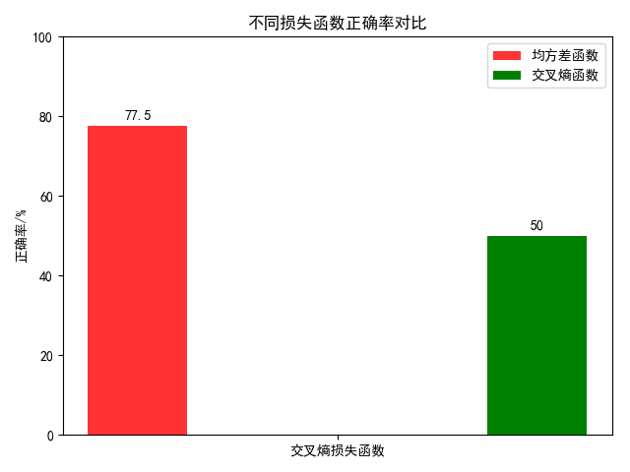
Loss Function
MSE cross-entropy
Notes:
The loss of Cross-entropy cost function is less than that of MSE, but has a lower accuracy. And it also has a High robustness

Slide 29
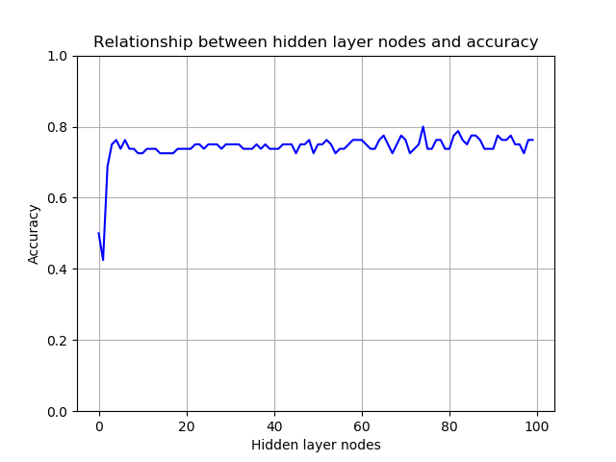
Number of Hidden Nodes

Slide 30
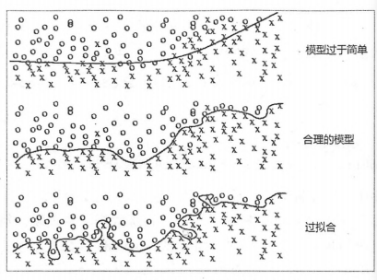
Regularization
the first case, the model is too easy, cannot reflect problem trends.
the second case, a. Don't pay too much attention to the noise in the training data, can describe the overall trend of the problem.
Overfitting.Perfectly divide points of different shapes, but can't make good judgments on unknown data
Use regularization to solve this problem.
Notes:
P87 Do not directly optimize the loss function, R(W)刻画的是模型的复杂度，lambda表示.....

Slide 31
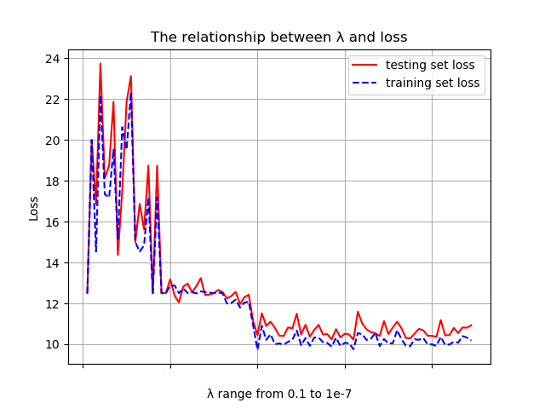
Regularization
Notes:
p87

Slide 32
Number of Hidden Layers
Number of Hidden Layers | Accuracy(%)
1 | 80
2 | 81.25
3 | 80
4 | 80
5 | 81.25

Slide 33
Contribution
Implementation & Testing：唐知行、邓鸿、蔡鑫鹏
Slides & Presentation：贺飞、熊志丽

Slide 34
Thank you!

